Slide 1


Mastering React Router: Seamless Navigation in Your SPAs
Navigate your React Single Page Applications (SPAs) with ease and efficiency. We'll cover all the essential concepts and best practices to boost your development workflow.
by Ritika Telang
Under the guidence of
Umar Solanki Sir

Slide 2
React Router: The Heart of SPAs
What is it?
Why Use it?
Enables smooth transitions between views, creates a user-friendly experience, and simplifies navigation logic.
React Router is a powerful library for managing navigation in React applications.
Uses JSX to define routes, making the code intuitive and readable.
Helps load and display different components or pages based on the URL.
Routes are dynamically rendered based on the application's state, rather than being hard-coded.
Encourages component-based design, making large applications easier to organize and maintain.

Slide 3


Installation: Getting Started
1
Install Package
2
Import Components
Use npm or yarn to install the React Router package.
Import necessary components from the 'react-router-dom' package.
3
Configure Router
Wrap your app with the 'BrowserRouter' component for routing functionality.

Slide 4
Core Components: Building Blocks of Navigation
BrowserRouter
Routes
The main router component that enables routing.
Defines the routes and their corresponding components.
Link/NavLink
Outlet
Components for creating interactive links to navigate between routes.
Renders the component associated with the current route.
useParams
useNavigate
Hook for accessing route parameters.
Hook for programmatically navigating to different routes.

Slide 5
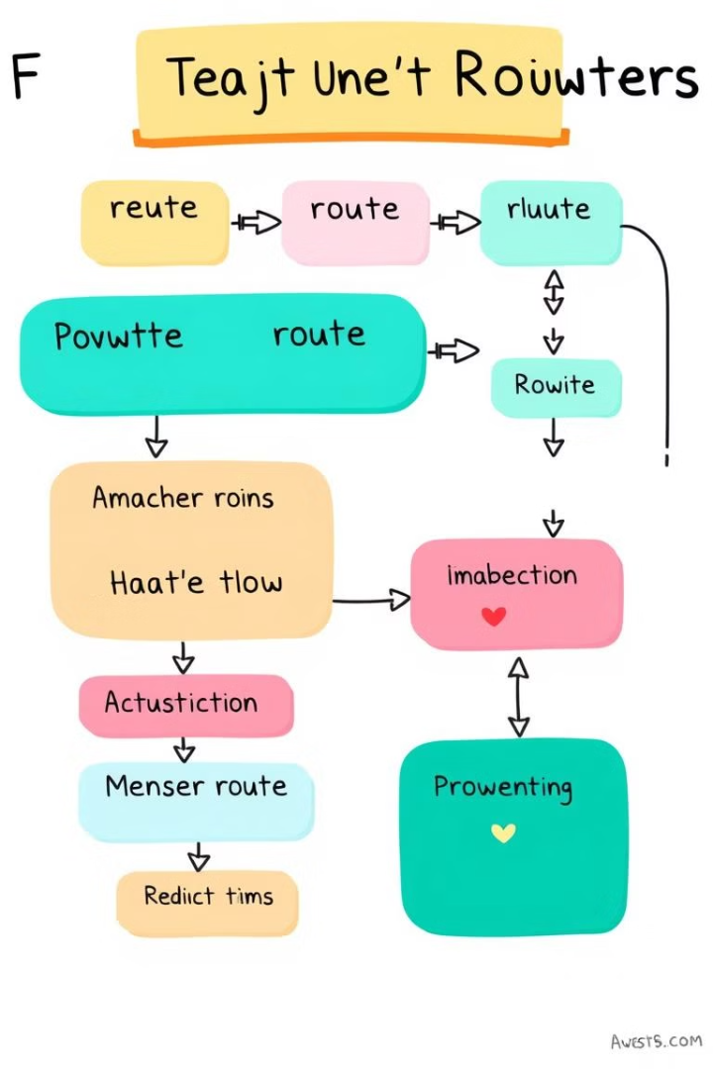




Advanced Routing: Enhancing Your Navigation
Nested Routes
Redirects
Organize routes hierarchically for complex applications.
Programmatically redirect users to different routes based on conditions.
Lazy Loading
404 Handling
Improve performance by loading components only when needed.
Display a custom error page for invalid routes.

Slide 6
Performance Optimization: Best Practices
1
Route Optimization
Minimize unnecessary rerenders, use efficient route matching.
2
Lazy Loading
Load components on demand, reducing initial bundle size.
3
Code Splitting
Divide your code into smaller chunks for faster loading.
4
Caching
Cache data to reduce server requests.

Slide 7

Hands-on Examples: Real-world Applications
import { BrowserRouter, Routes, Route, Link, Outlet, useParams, useNavigate } from 'react-router-dom';
function App() {
return (
} />
} />
} />
} />
);
}

Slide 8

Conclusion: Take Your Navigation to the Next Level
React Router is a powerful library that enables seamless navigation and dynamic routing in React applications unnecessary rerenders, use efficient route matching.
By leveraging its features such as nested routes, route parameters, and dynamic loading, developers can create complex and user-friendly web applications with ease.
Understanding React Router not only enhances the user experience but also contributes to efficient and organized code.

